Slide 1


LEARN
RUST
NOW!
Harold Medina, Aigul Yermagambetova
Notes:
ID=d924773e-9a16-4d6d-9803-8cb819e99682 Recipe=text_billboard Type=TextOnly Variant=0 FamilyID=AccentBoxWalbaum_Zero

Slide 2


Our Team
Aigul Yermagambetova
Harold Medina

Slide 3

Agenda
Why Rust?
Intro
Installation
Basics
Assignment
Summary

Slide 4
https://github.com/aigul-ermak/web-advanced-rust
clone repo

Slide 5
Why Rust?
Rust
Installation
Basics
Variables and Const
Struct
Flow of Control
Function
Data Types
Trait
Enums
Common collections
Memory Management

Slide 6
Why Rust?

Slide 7
Rust is
Compiled language like C, Java and C#
High-level simplicity with low-level performance
Great choice for building systems [OS / Game Engines / Databases]

Slide 8
Main Characteristics
Safety.
No Garbage Collection.
Speed.
Multithreading and Asynchronous Programming.
Statically Typed.

Slide 9
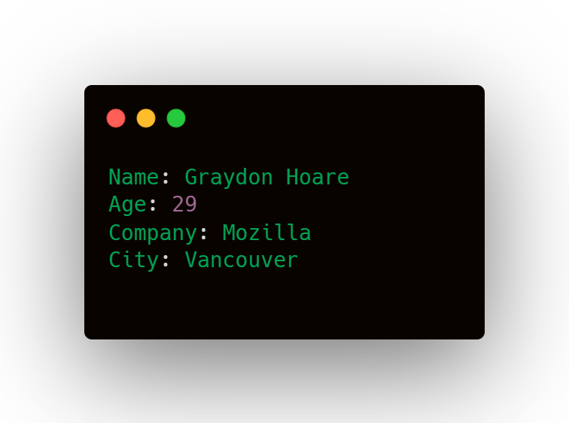
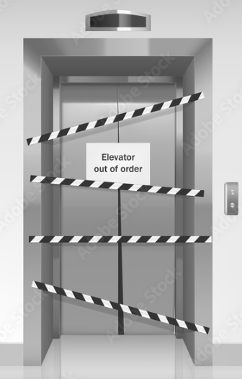

Rust :: History
It’s ridiculous!!!
Why we couldn’t even make an elevator that works without crashing?

Slide 10
Benchmark
Description
Test Technologies
The benchmark consists of a stress test that consists of the same concurrent tasks in different program languages as Rust, Go, Java, C#, Python, Node.js and Elixir.
The test grew the number of Tasks executed by iteration, starting with one, ten thousand, 100 thousand, and finishing with 1 million tasks.
More information in (Kołaczkowski, 2021).
Technology | Description
Hardware | Intel(R) Xeon(R) CPU E3-1505M v6 @ 3.00GHz
Operative System | Ubuntu 22.04 LTS, Linux p5520 5.15.0-72-generic
Rust | 1.69
Go | 1.18.1
Java | OpenJDK “21-ea” build 21-ea+22-1890
.NET | 6.0.116
NodeJS | 12.22.9
Python | 3.10.6
Elixir | Erlang/OTP 24 erts-12.2.1, Elixir 1.12.2

Slide 11
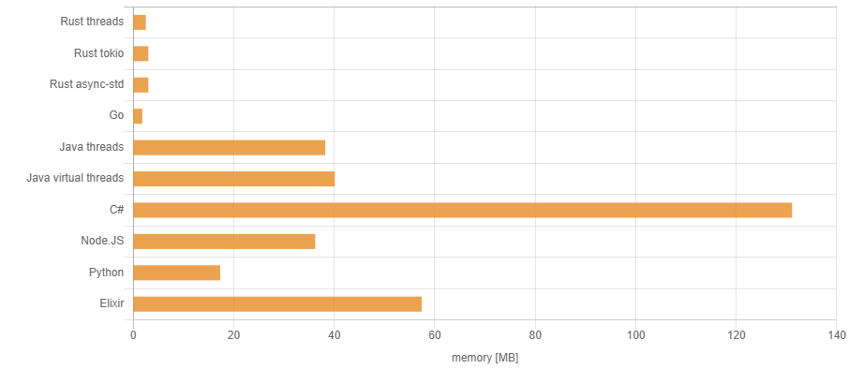
Benchmark For 1 Task
Memory Used By Concurrent Tasks
Picture taken from (Kołaczkowski, 2021).

Slide 12
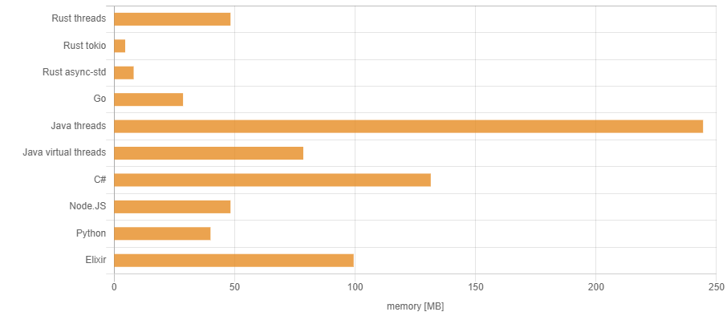
Benchmark For 10K Task
Memory Used By Concurrent Tasks
Picture taken from (Kołaczkowski, 2021).

Slide 13
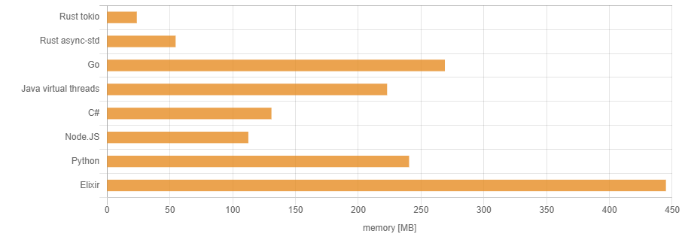
Benchmark For 100K Task
Memory Used By Concurrent Tasks
Picture taken from (Kołaczkowski, 2021).

Slide 14
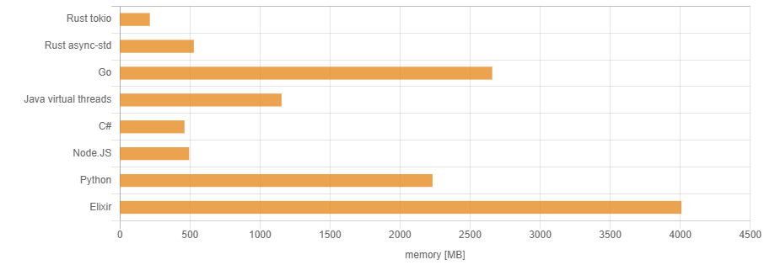
Benchmark For 1 Million Task
Memory Used By Concurrent Tasks
Picture taken from (Kołaczkowski, 2021).

Slide 15
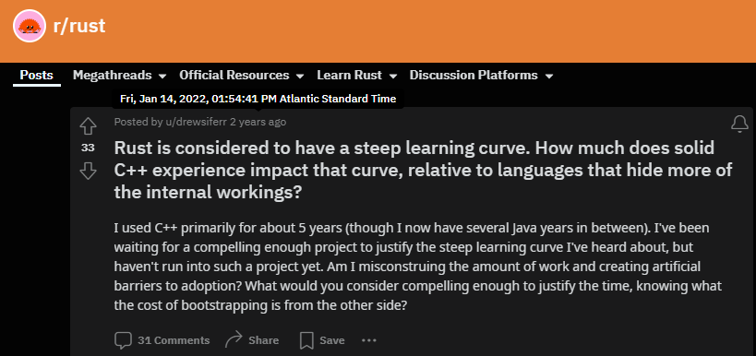
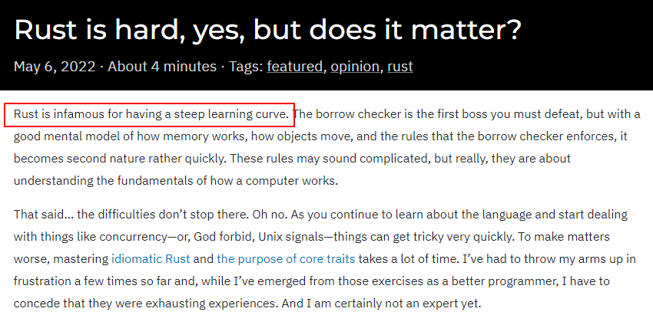
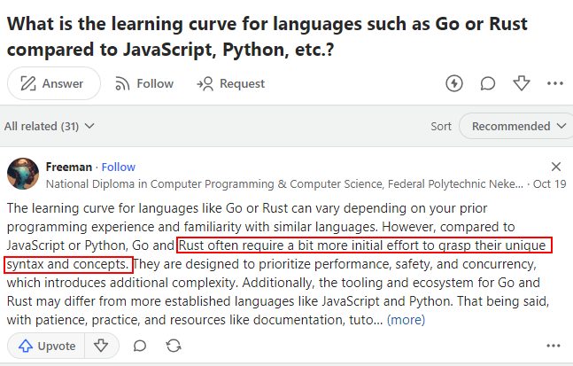
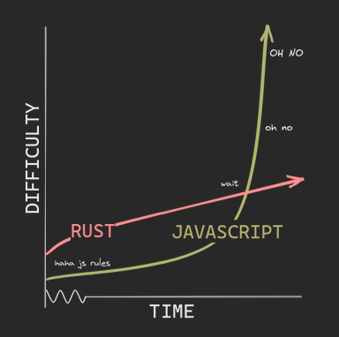
Rust learning curve

Slide 16





What projects have used Rust?
the graphic editor’s multiplayer server written in TypeScript was no longer enough, so it was rewritten in Rust
both the codebase’s client and server sides are coded in Rust
some of Amazon’s cloud services are built completely in Rust, e.g., Amazon S3, Amazon EC2, and others
the operating system added Rust support to the Android Open Source Project
Mozilla’s browser uses Rust for its CSS engine

Slide 17

Rust Installation
For Windows:
Visual Studio Code
https://www.rust-lang.org/tools/install
For Linux or macOS:
$ curl --proto '=https' --tlsv1.2 https://sh.rustup.rs -sSf | sh
// Rust is installed now. Great!
Download the installer
Follow the onscreen instructions
You may need to install the Visual Studio C++ Build tools when prompted to do so

Slide 18
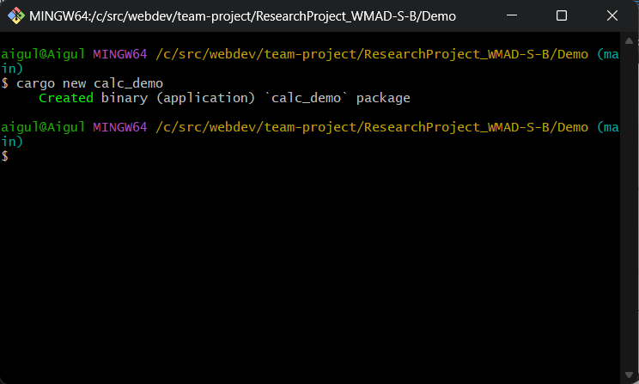
Cargo – Rust package manager
cargo install
https://doc.rust-lang.org/beta/cargo/getting-started/installation.html
Once Rust is installed, open a terminal and navigate to the directory
Create new project - cargo new project_name

Slide 19
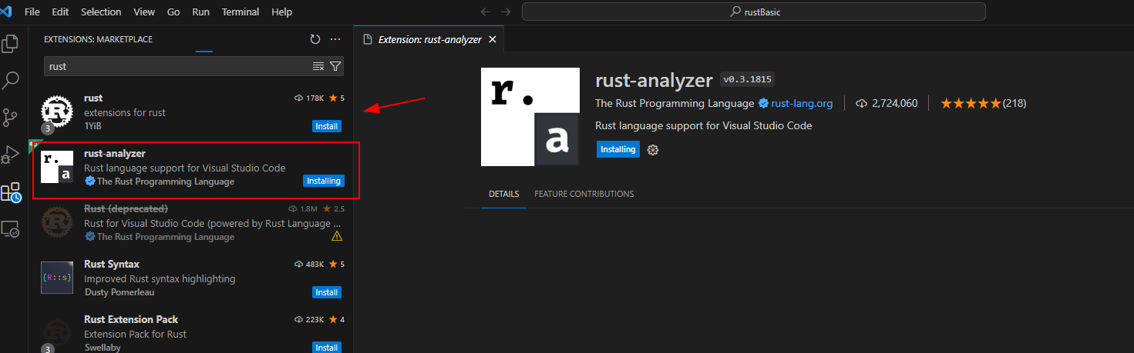
Install extension rust-analyzer
Tool for working with the Rust
Real-time Code Analysis
Offers intelligent code competition
Go to Definition and Find References

Slide 20
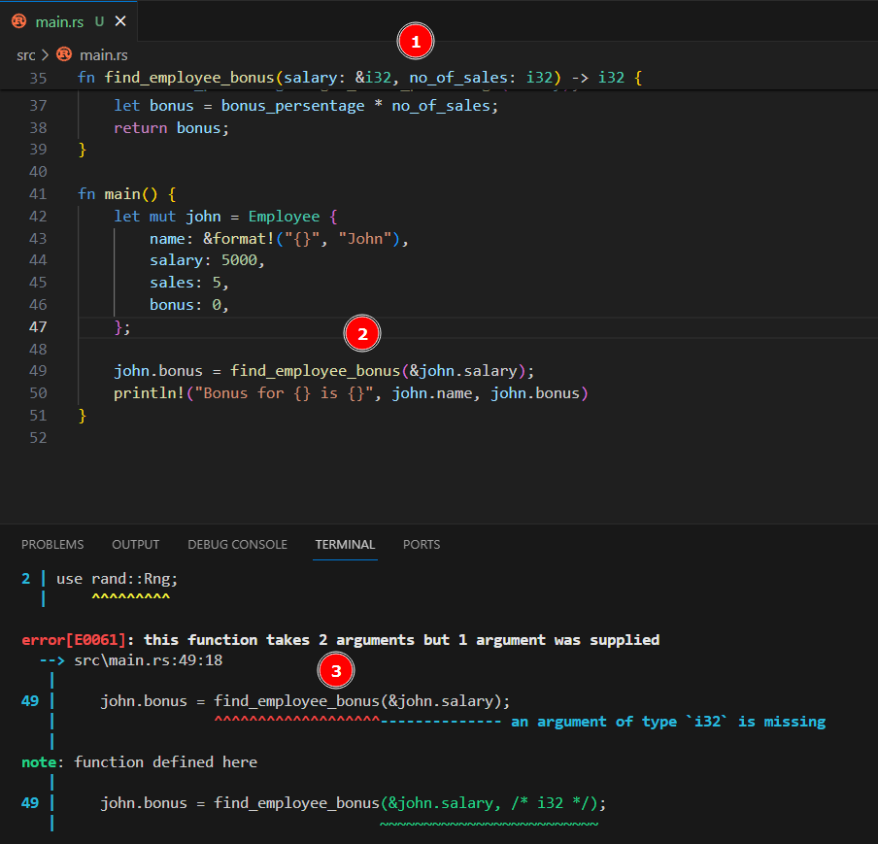
Without rust-analyzer

Slide 21
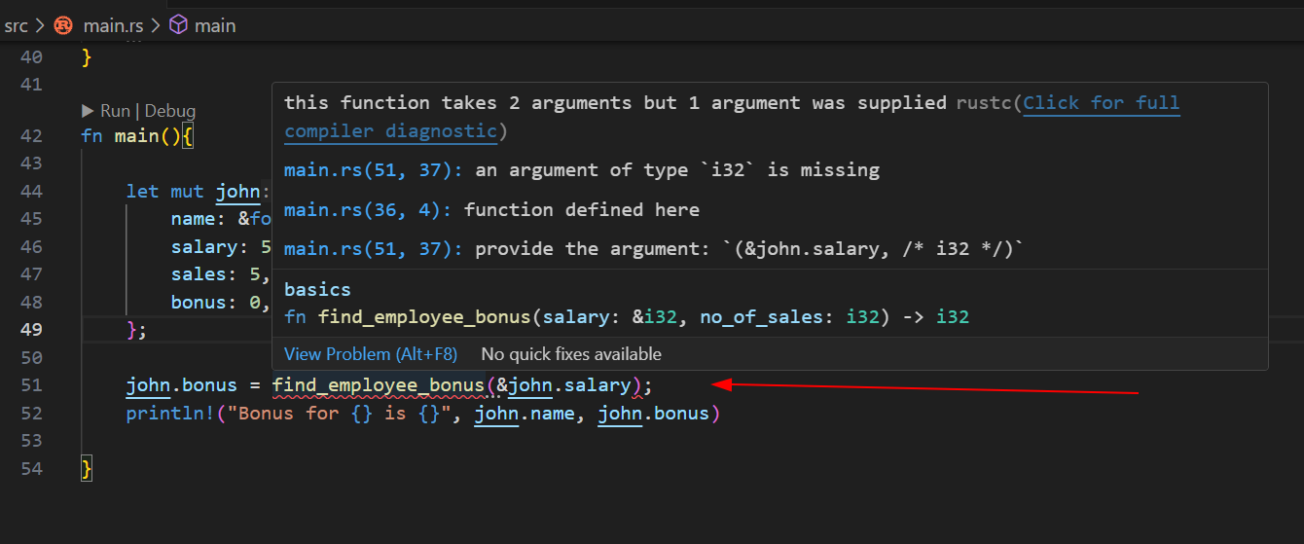
With rust-analyzer

Slide 22
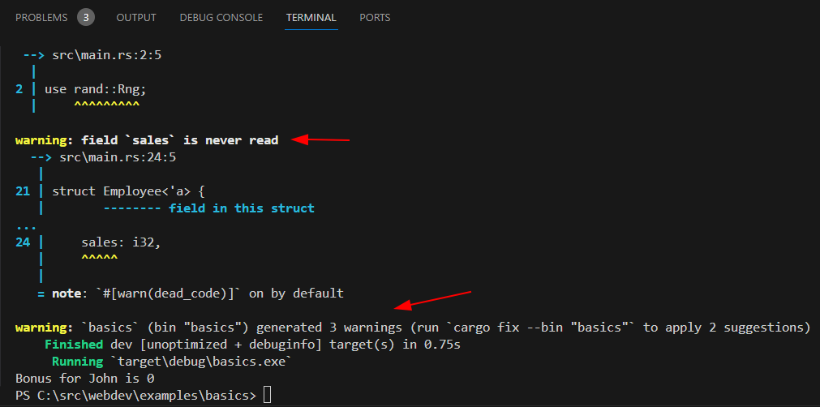
Rust compiler

Slide 23

Uninstall Rust
rustup self uninstall

Slide 24
Basics

Slide 25
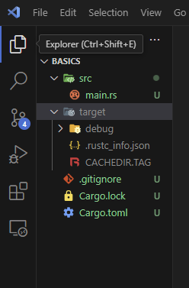
Setting Up a New Project
src/rust/
cargo new basics

Slide 26
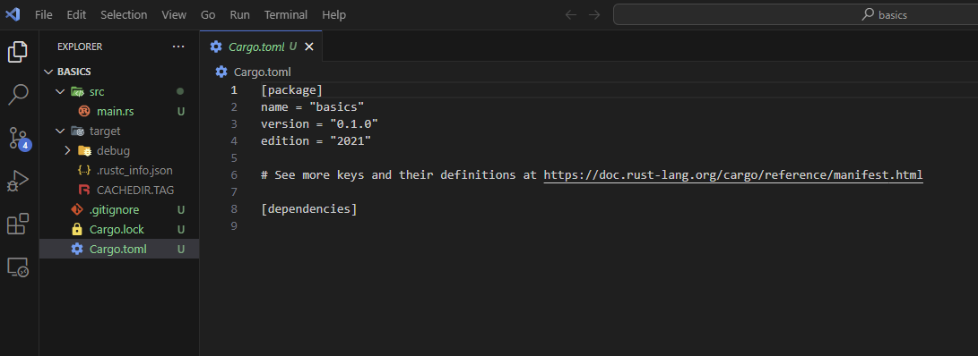
Cargo.toml

Slide 27
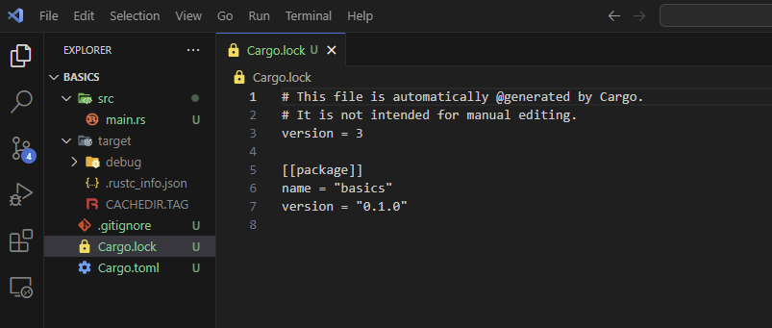
Cargo.lock

Slide 28
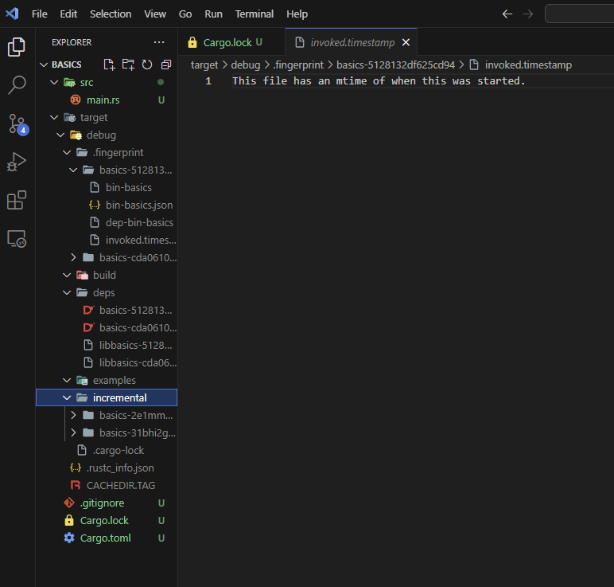
target

Slide 29
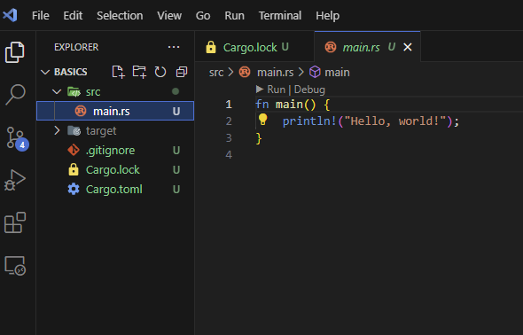
src/main.rs
entry point of a program

Slide 30
; the semi-colon tells the compiler where one statement ends . dots are typically used to access fields of a value or call a method on a value snake case is the naming convention in which each space is replaced an underscore (_) character use directives can be used to “bring in scope” names from other namespaces
Common programming concepts

Slide 31
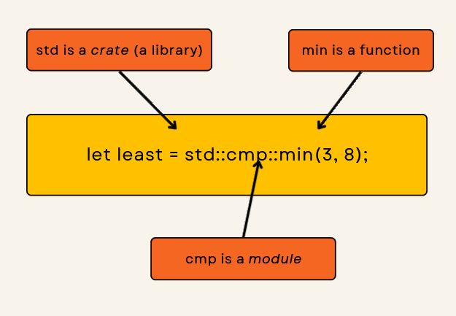
:: is used to navigate through modules or namespaces to access functions, structs, enums, or constants defined within them
Common programming concepts

Slide 32
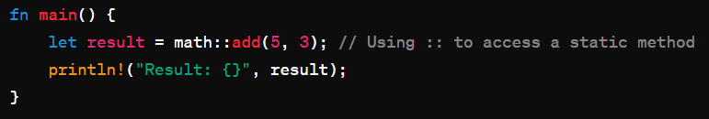
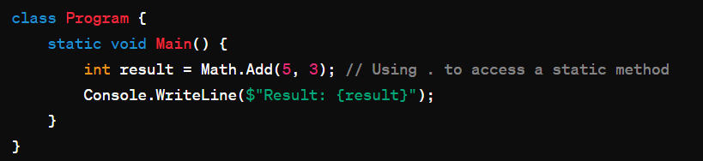
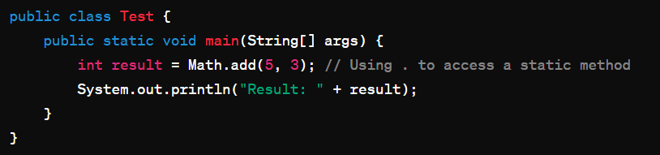
:: is used to navigate through modules or namespaces to access functions, structs, enums, or constants defined within them
Common programming concepts
C#
Java

Slide 33

The exclamation mark (`!`) after println indicates `println1` is a macro and not a function. Macros and functions both aim to reduce the amount of code a programmer needs to write and maintain

Slide 34
Macro:
Metaprogramming – write code that generates other code
Can accept a variable number of parameters
Complex to define they involve writing code generates other Rust code
Must define before call
Function:
Reusable logic into a single, callable entity
Have signature, requiring a specific number and type of parameters
Easier to read, understand, and maintain
Define anywhere and call anywhere
println!
vec!

Slide 35
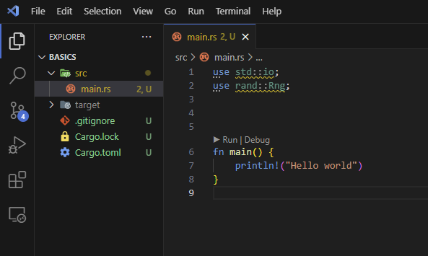
use std::io
Input/Output (I/O) library
std
The standard library is a collection of commonly used functionalities that Rust provides out-of-the-box

Slide 36
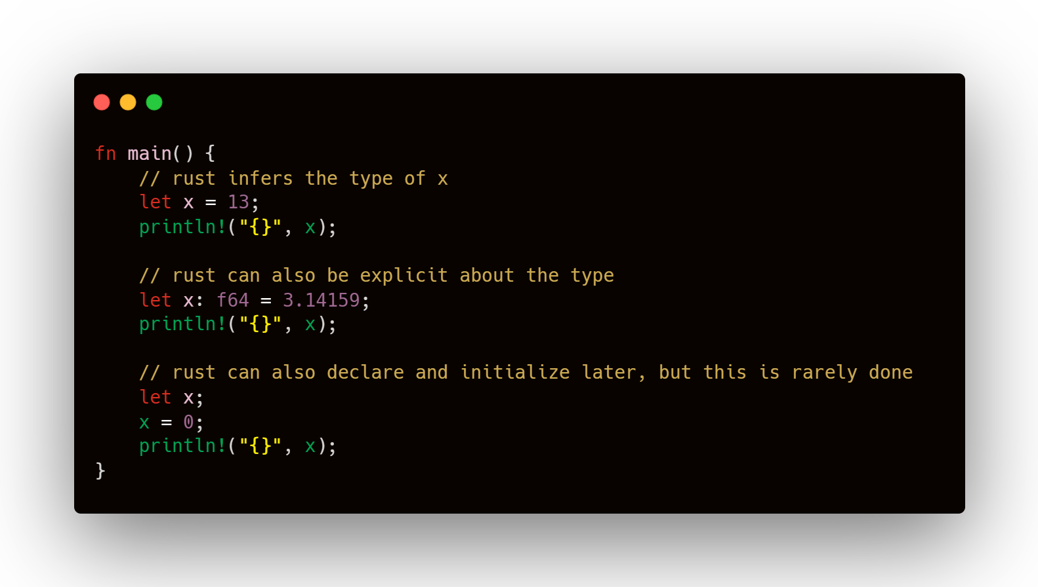
Variables

Slide 37
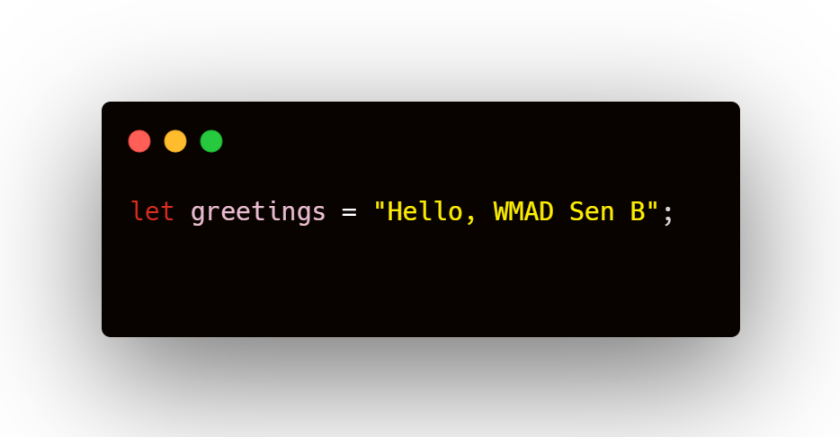
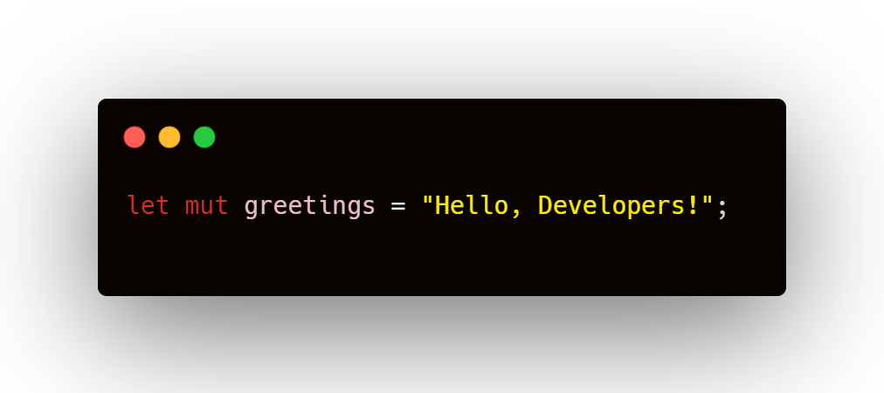
Variables are immutable by default
To make them mutable, add mut before variable name

Slide 38
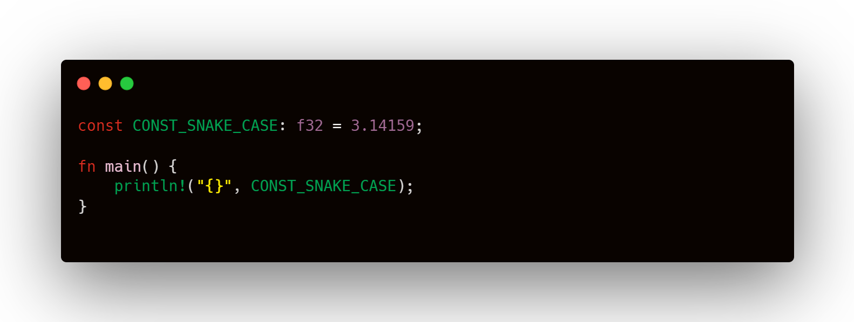
Const

Slide 39
Data Types

Slide 40
Rust Data Types
Primitive
Compound
Custom
Primitive / Scalar
Integer
Floating-point
Boolean
Character
Custom
Struct
Enum
Compound
Tuple
Array

Slide 41

Scalar Types
an integer
is a number without fractional component
represents a single value
Length
16-bit
32-bit
64-bit
128-bit
arch
Signed
i16
i32
i64
i128
isize
Unsigned
u16
u32
u64
u128
usize
Signed integers :: represent both positive and negative numbers.
Unsigned :: non-negative numbers (positive and zero)
isize and usize types depend in the architecture of the computer your program is running on

Slide 42
Scalar Types
represents a single value
Unsigned Integers
Type | Max Value
u8 | 255
u16 | 65_535
u32 | 4_294_967_295
u64 | 18_446_744_073_709_551_615
u128 | 340_282_366_920_938_463_463_374_607_431_768_211_455
usize | Depending on platform pointer size, same as u16, u32, or u64.
+ Represent a wider range of positive values
+Simple Arithmetic
+ Predictable Overflow
- No negative numbers
- Overflow Can Be Unintuitive
- Type Compatibility and Conversion Issues

Slide 43
Scalar Types
Signed Integers
represents a single value
Type | Max Value
i8 | 255
i16 | 65_535
i32 | 4_294_967_295
i64 | 18_446_744_073_709_551_615
i128 | 340_282_366_920_938_463_463_374_607_431_768_211_455
isize | Depending on platform pointer size, same as i16, i32, or i64.
+ Range of Values
+ Mathematical Operations
+ Compatibility
Type | Min Value
i8 | -128
i16 | -32_768
i32 | -2_147_483_648
i64 | -9_223_372_036_854_775_808
i128 | -170_141_183_460_469_231_731_687_303_715_884_105_728
isize | Depending on platform pointer size, same as i16, i32, or i64
- Reduced Positive Range
- Overflow and Underflow
- Potential for Bugs

Slide 44
fn main() {
// Floating-Point Types
let x = 2.0; // f64
let y: f32 = 3.0; // f32
// Boolean type
let t = true;
let f: bool = false; // with explicit type annotation
// Character type
let c = 'z';
let z: char = 'ℤ'; // with explicit type annotation
let heart_eyed_cat = '😻';
}
Scalar Types
fn main() {
// Floating-Point Types
let x = 2.0; // f64
let y: f32 = 3.0; // f32
// Boolean type
let t = true;
let f: bool = false; // with explicit type annotation
// Character type
let c = 'z';
let z: char = 'ℤ'; // with explicit type annotation
let heart_eyed_cat = '😻';
}
represents a single value

Slide 45
Numeric Operations
fn main() {
// addition
let sum = 5 + 10;
// subtraction
let difference = 95.5 - 4.3;
// multiplication
let product = 4 * 30;
// division
let quotient = 56.7 / 32.2;
let truncated = -5 / 3; // Results in -1
// remainder
let remainder = 43 % 5;
}

Slide 46
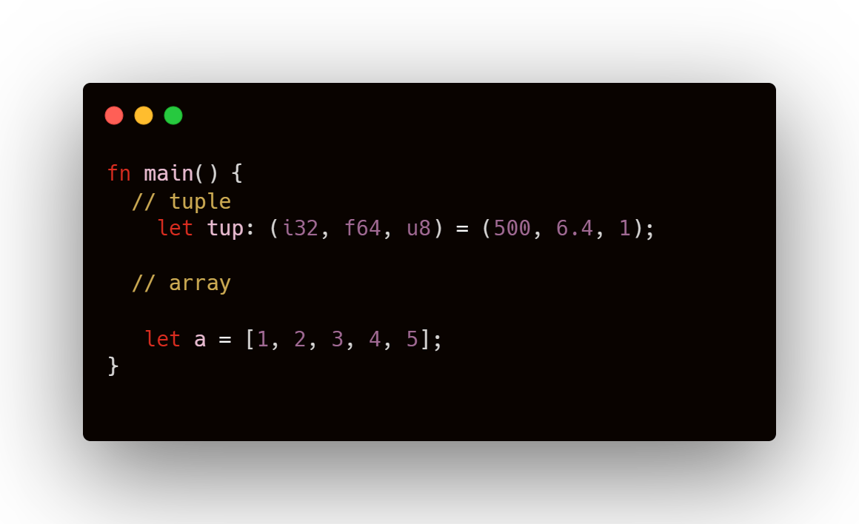
Compound Types
Compound types can group multiple values into one type.
Rust has two primitive compound types: tuples and arrays.
Tuples is a collection of values of different types
Arrays is a collection of object of the same type

Slide 47
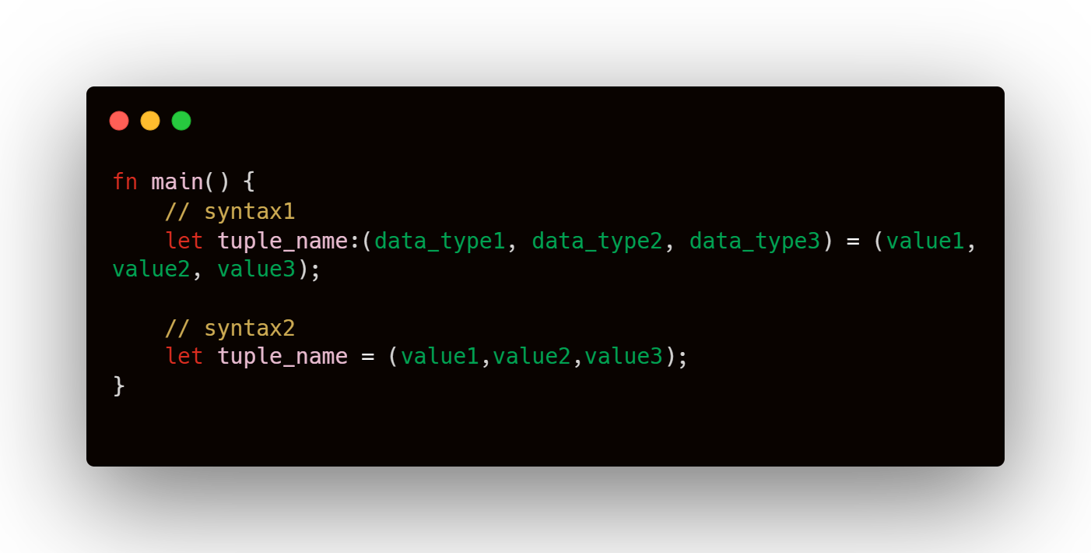
Tuple
Has a variety of types into one compound type
Has fixed length
Once declared,
they cannot grow or shrink in size

Slide 48
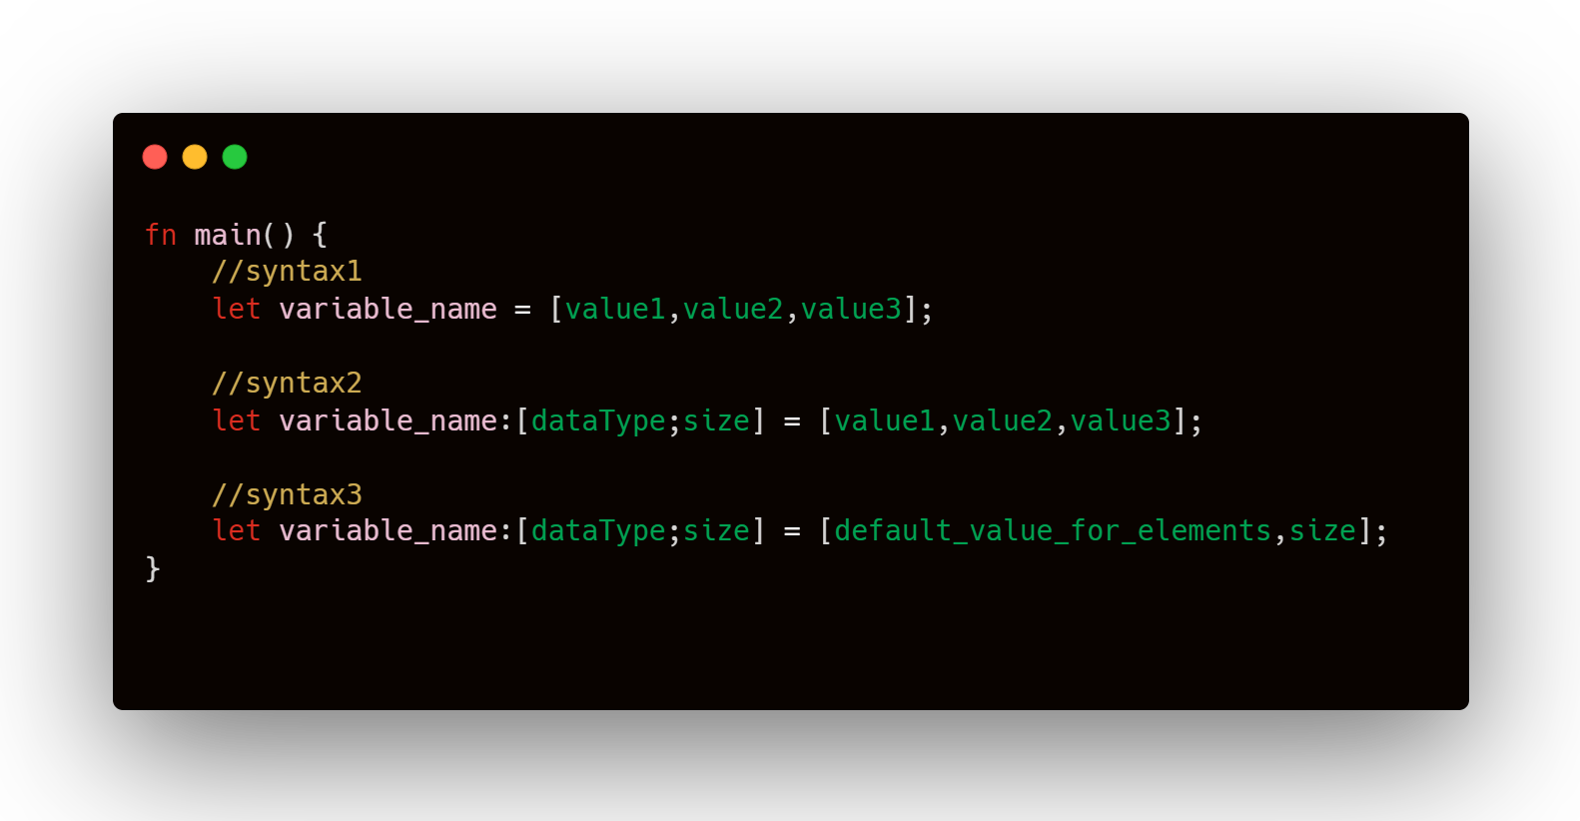
Array
Must have the same type
Has fixed length

Slide 49
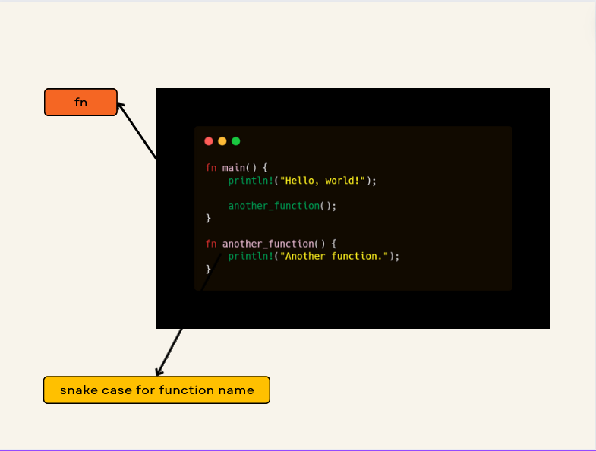
Function in Rust

Slide 50
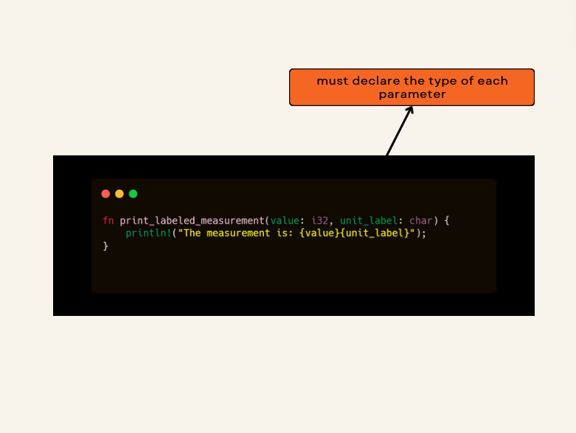
Function’s Parameters

Slide 51
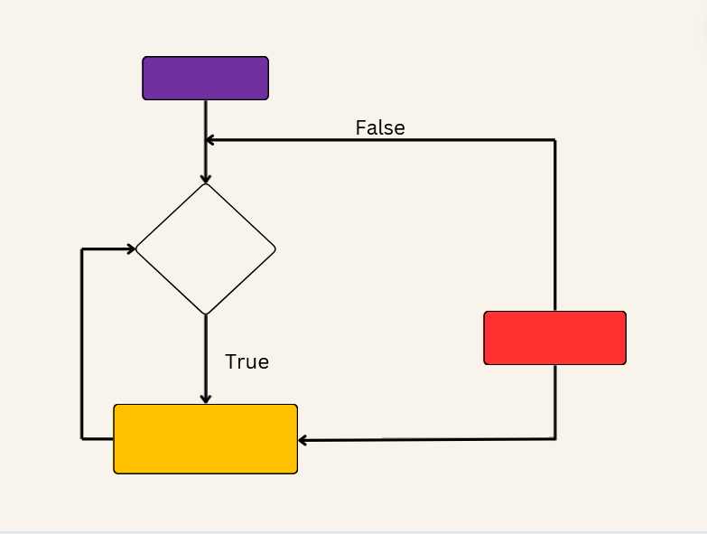
Flow of Control in Rust

Slide 52
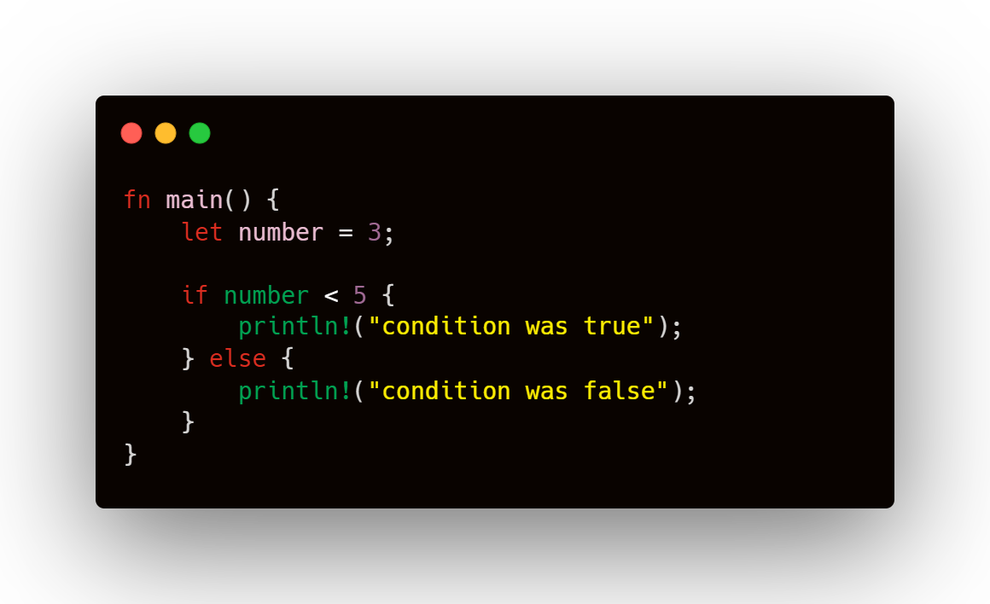
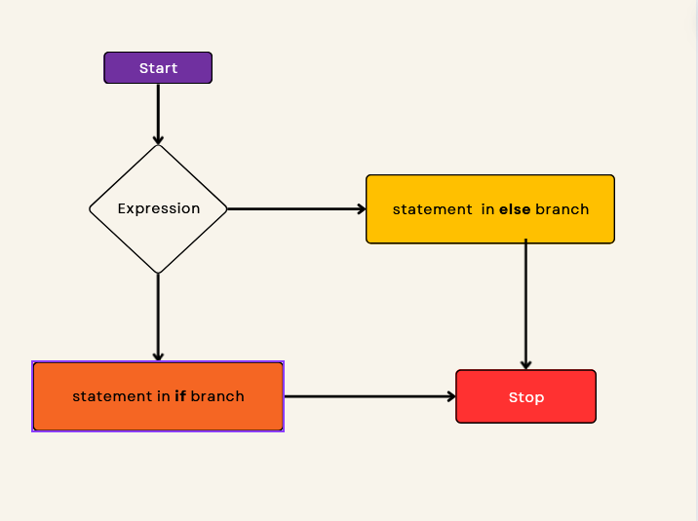
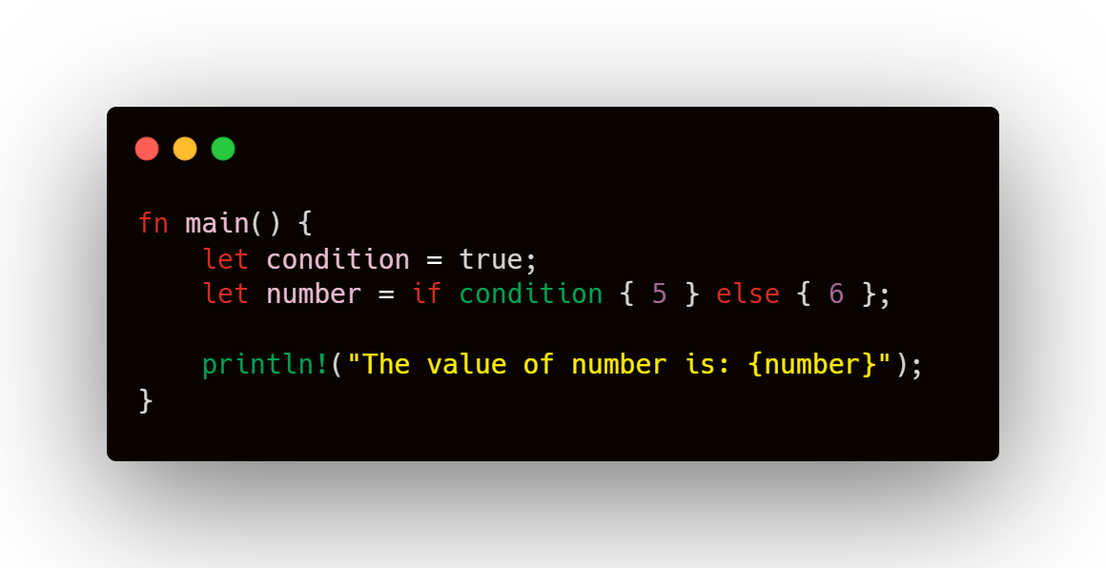
if else

Slide 53
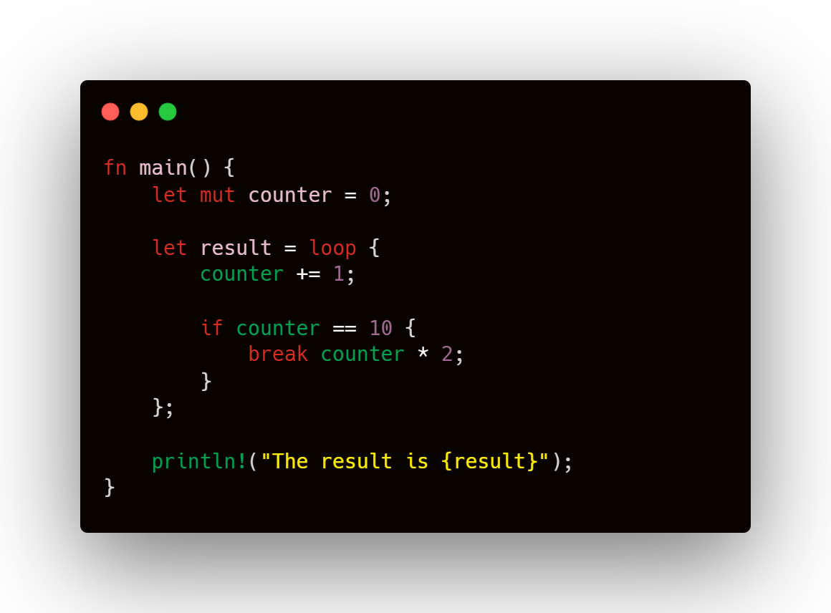
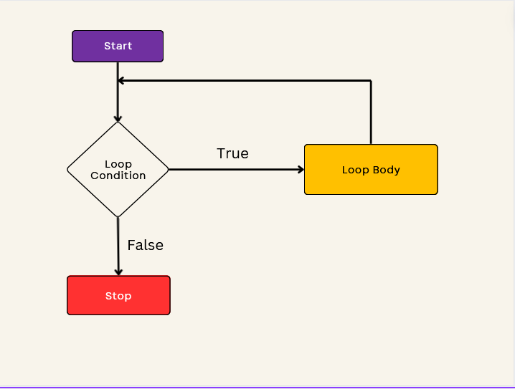
loop

Slide 54
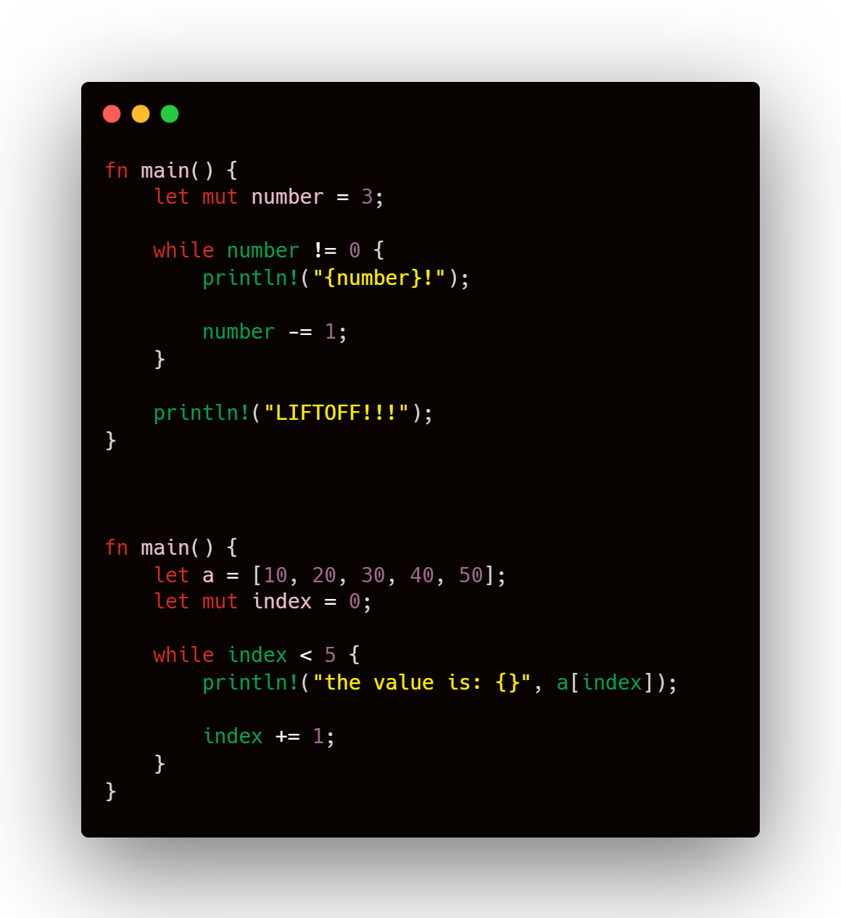
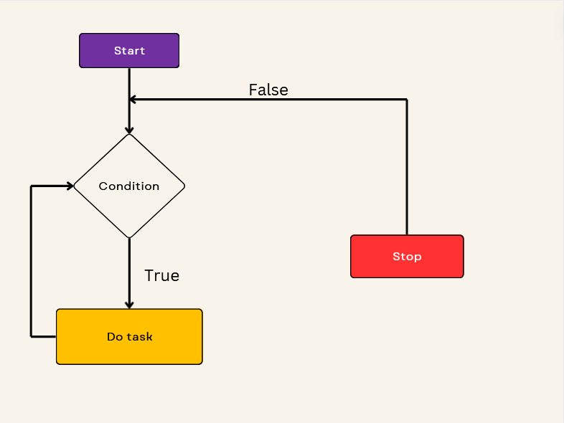
while loop

Slide 55
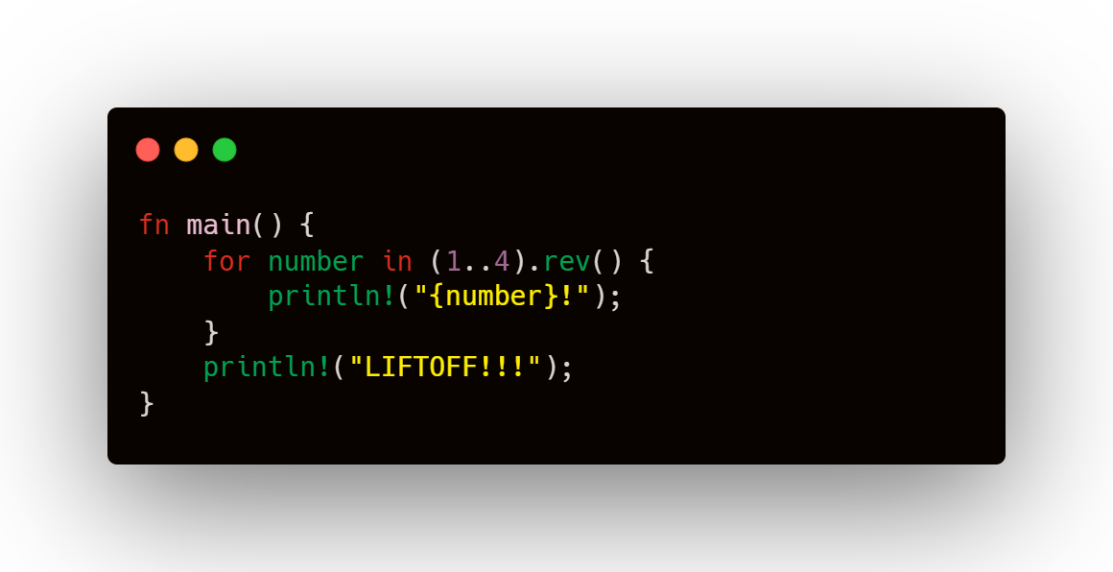
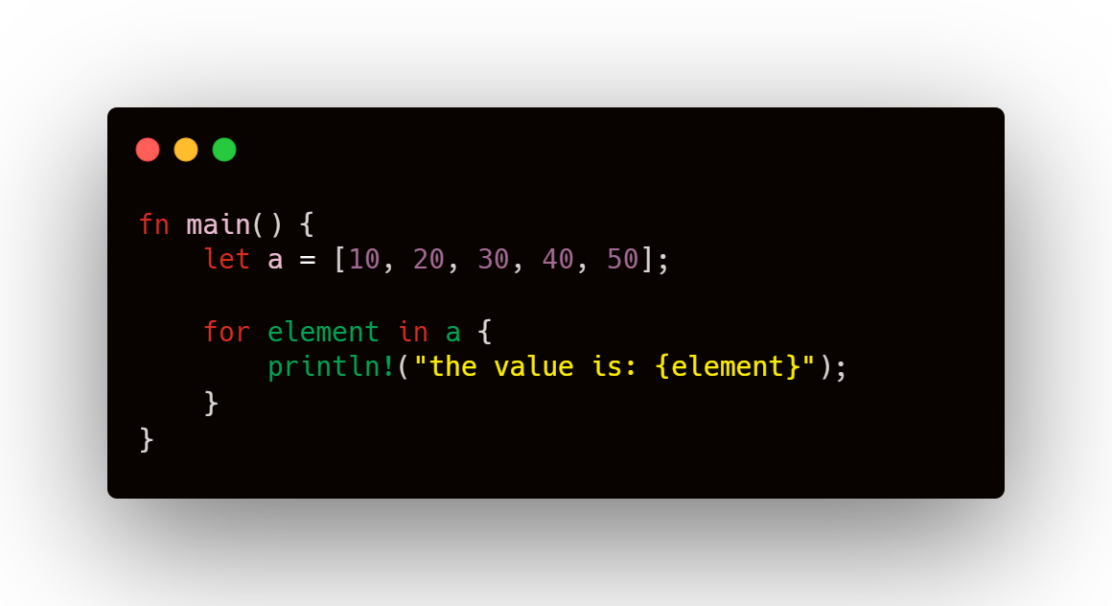
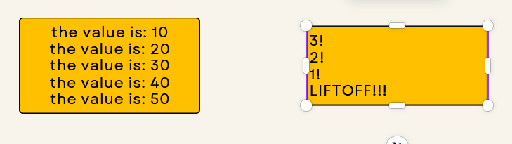
For loop

Slide 56
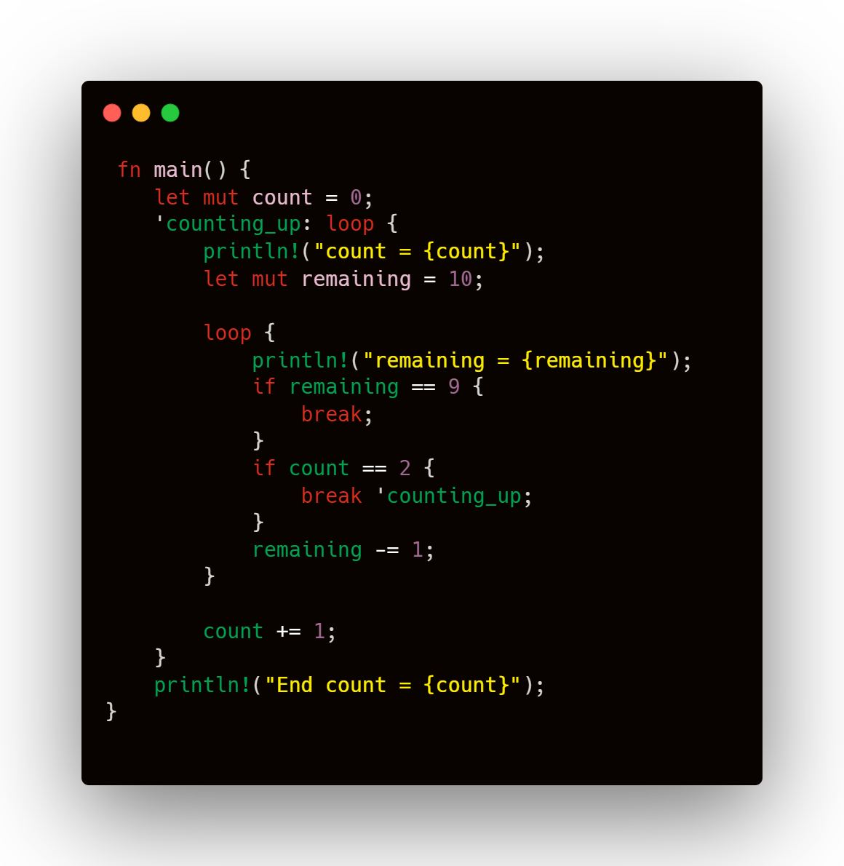
Multiple loops

Slide 57
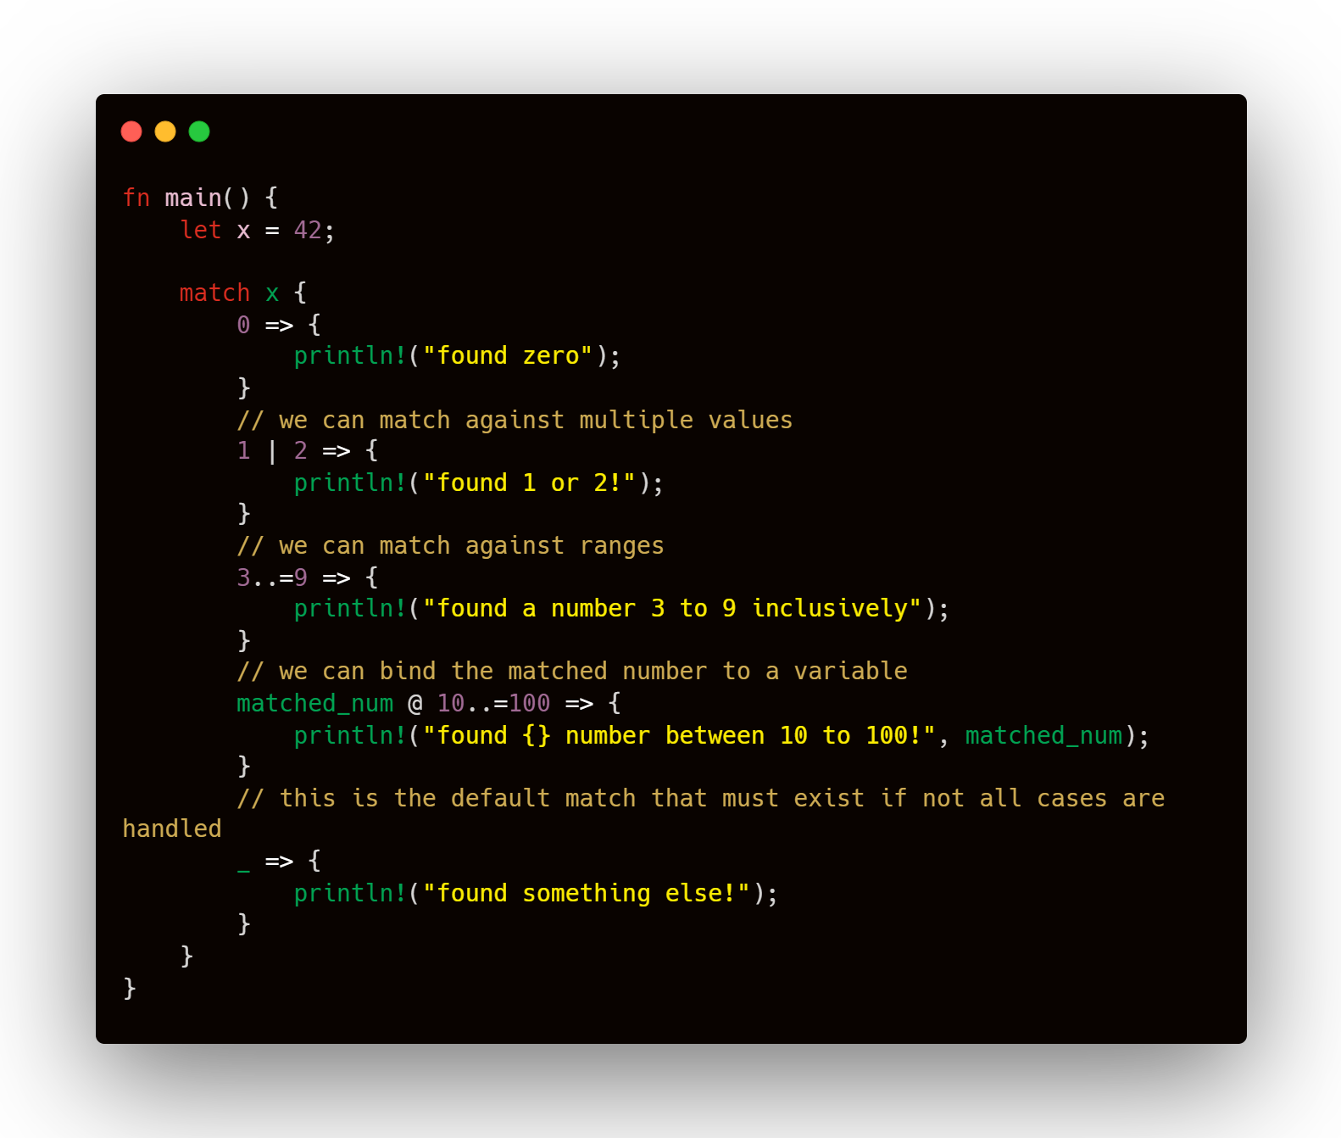
match

Slide 58
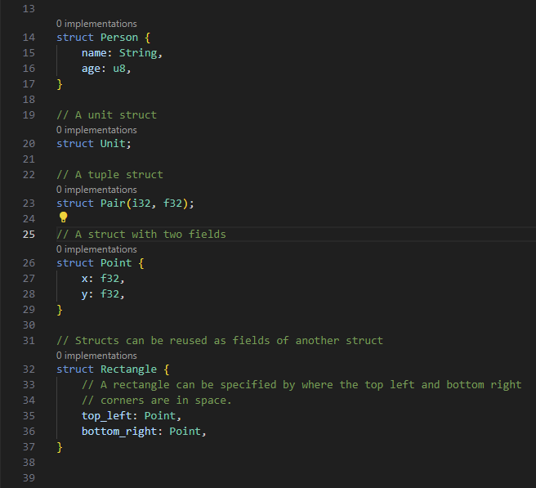
Custom Types
Struct
define a structure

Slide 59
The comparison between structs in Rust and classes in Java

Slide 60
Groups multiple pieces of data
struct Book {
title: String,
author: String,
pages: u32,
}
impl Book {
fn new(title: String, author: String, pages: u32) -> Book {
Book { title, author, pages }
}
fn description(&self) -> String {
format!("{} by {}, {} pages", self.title, self.author, self.pages)
}
}
fn main() {
let book = Book::new(String::from("The Rust Programming Language"),
String::from("Steve Klabnik and Carol Nichols"), 552);
println!("{}", book.description());
}
No Constructor
Define methods

Slide 61

public class Book {
public string Title { get; set; }
public string Author { get; set; }
public int Pages { get; set; }
public Book(string title, string author, int pages) {
Title = title;
Author = author;
Pages = pages;
}
public string Description() {
return $"{Title} by {Author}, {Pages} pages";
}
}
class Program {
static void Main() {
Book book = new Book("The Rust Programming Language", "Steve Klabnik and Carol Nichols", 552);
Console.WriteLine(book.Description());
}
}
Blueprint for objects
Constructor
Methods inside class

Slide 62
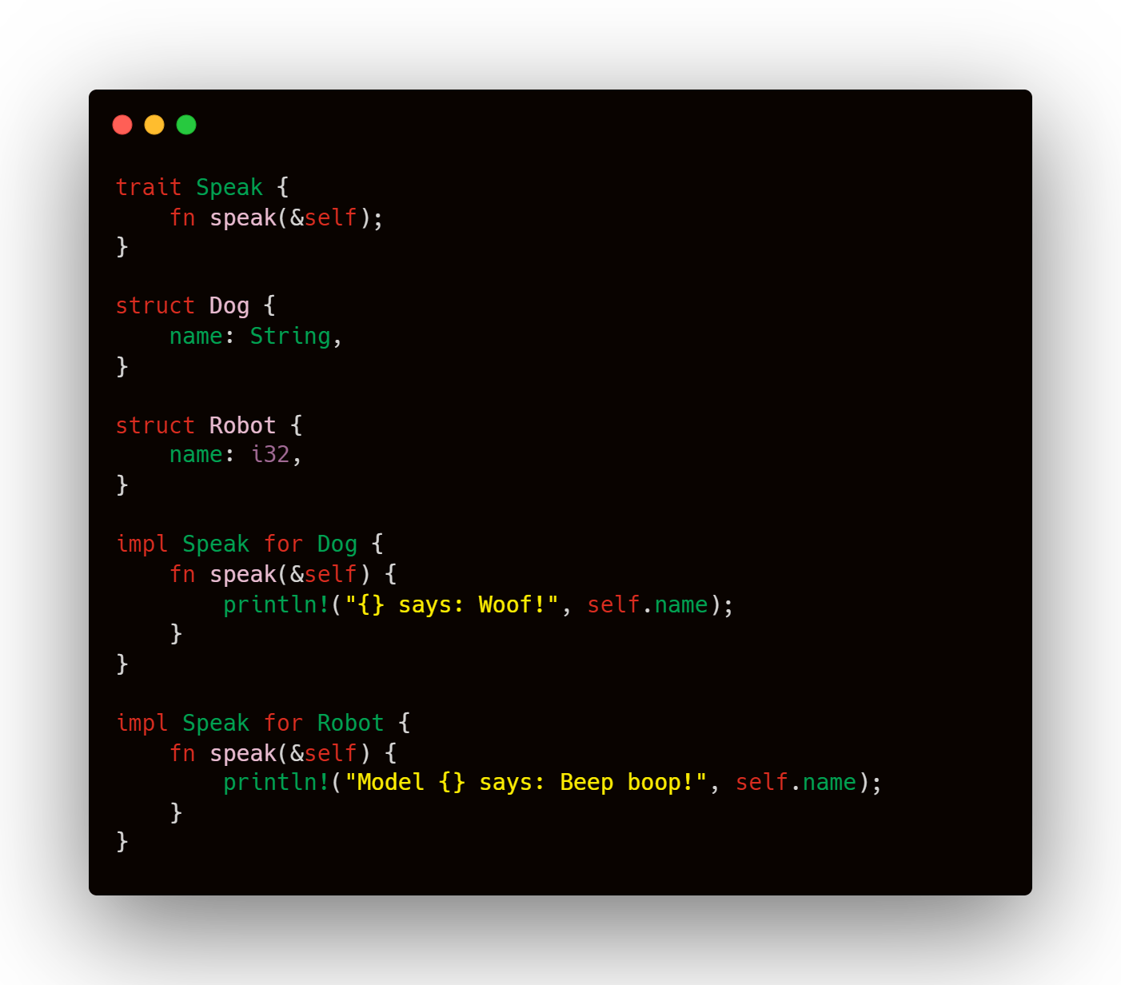
Traits
Collection of methods defined for an unknown type: self

Slide 63
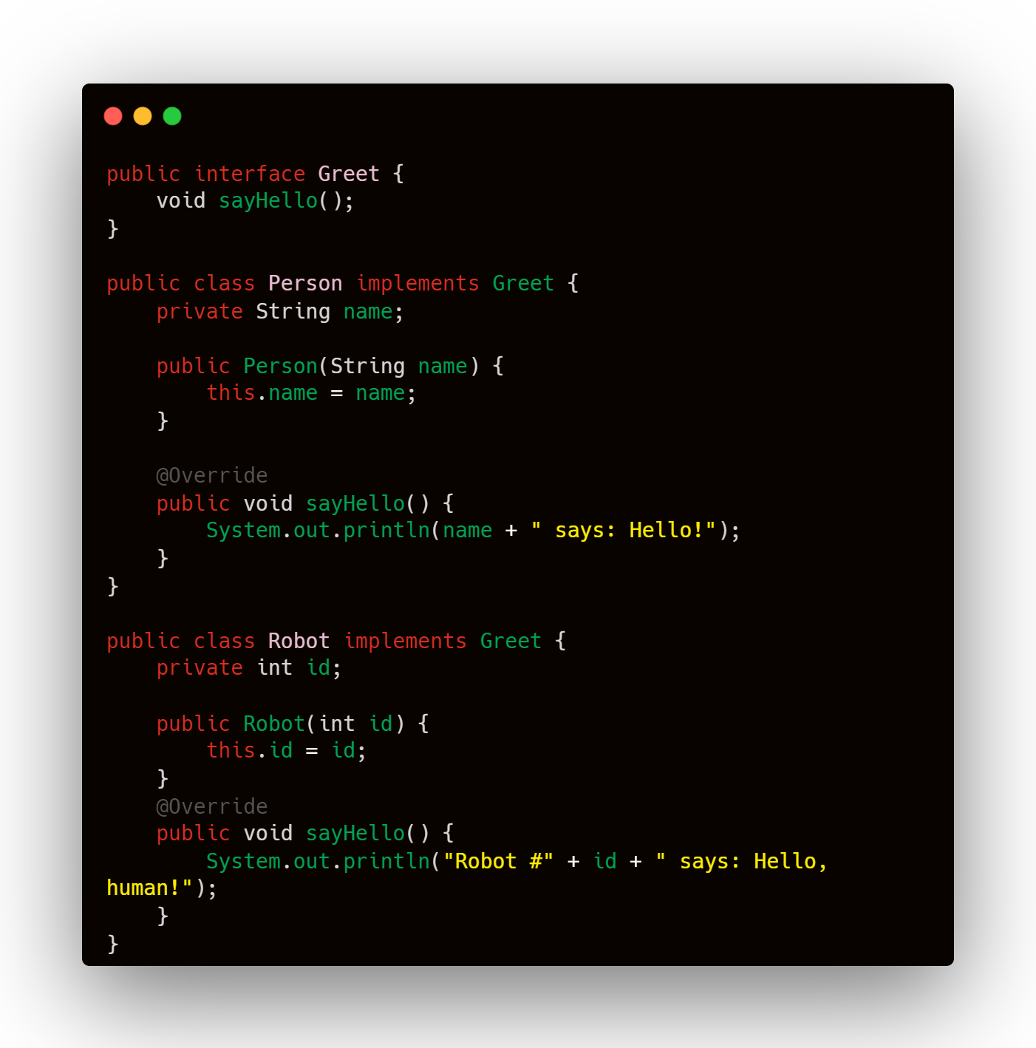
Java
Java interfaces can clash if they require methods with the same name but different return types.
Java interfaces allow generics but restrict a class to implement a specific interface only once, which can be limiting.

Slide 64

Rust
In Rust, each trait has a separate namespace, allowing different traits to define methods with the same name without conflict.
Rust traits can be implemented for multiple types, considering each implementation as distinct.

Slide 65

Enums
define an enumeration

Slide 66
enum UserRole {
Admin,
User,
Guest,
}
impl UserRole {
fn display_role(&self) {
match self {
UserRole::Admin => println!("Role: Admin"),
UserRole::User => println!("Role: User"),
UserRole::Guest => println!("Role: Guest"),
}
}
}
fn main() {
let role = UserRole::User;
role.display_role();
}
Methods
Pattern Matching

Slide 67

public enum UserRole {
Admin,
User,
Guest
}
public class UserRoleMethods {
public static void DisplayRole(UserRole role) {
switch (role) {
case UserRole.Admin:
Console.WriteLine("Role: Admin");
break;
case UserRole.User:
Console.WriteLine("Role: User");
break;
case UserRole.Guest:
Console.WriteLine("Role: Guest");
break;
}
}
}
public class Program {
public static void Main() {
UserRole role = UserRole.User;
UserRoleMethods.DisplayRole(role);
}
}

Slide 68

Representing Nothing

Slide 69
Common Collections
Vector
Number of very useful data structures called collections
String
Hash Map

Slide 70

Vector
Dynamic data structure that can store a list of elements of the same type.
Vector are re-sizable arrays.

Slide 71

Strings
Collection of characters
String type
str

Slide 72
String
sequence of UTF-8 characters
mutable
owned
heap-allocated (can be resize at runtime)
Using
when we need to modify or own string
str (string slice)
sequence of valid UTF-8 characters
immutable reference
point to the entire section or subsection
Using
&str
immutable reference
&mut str
mutable reference

Slide 73

HashMap
Data structure allows to store data in key-value pairs.
Features of hashmap:
+ Each value is associated with a corresponding key
+ Keys are unique, whereas values can duplicate.
+ Values can be accessed using their corresponding keys.

Slide 74

Memory management . Stack and Heap in Rust.

Slide 75
Garbage collection – Automatic Memory Manager
Manual Memory Management
All programs have to manage the way they use a computer’s memory while running.

Slide 76



Manages memory explicitly to avoid leaks
Uses garbage collection to manage memory automatically
Has Dedicated Heap
Automatic Memory Management

Slide 77
What is Memory allocation?
Process of reserving a portion of computer memory for programs and processes to run

Slide 78
Memory is managed through a system of ownership with set of rules
If any of the rules are violated, the program won’t compile.

Slide 79
Stack and heap are generic terms for different ways to allocate memory.
6
5
4
2
3
9
3
7
5
2
4
6
1
1

Slide 80
Why Rust make us think about it?
Whether a value in memory is on the stack or the heap affects how the Rust behaves

Slide 81
Heap
Data is unknown size
Accessing data in a heap is slower
Data might change size on runtime
Managing memory for the heap is non-trivial
Data type that are in size, such as String, Vector, Box, etc., are allocated on the heap

Slide 82
Stack
Accessing data in the stack is faster
Rust stack allocates by default
Data is fixed size
Data stores in the order
Last in, First out (LIFO)
Managing memory and local variables of a function are allocated on the stack
Primitive types and local variables of a function are allocated on the stack

Slide 83

As you remember:
Variables are immutable by default
To make them mutable, add mut before variable name

Slide 84


Stack
Heap

Slide 85

Ownership
Ownership Rules:
Each value in Rust has a variable that’s called `owner`
There can only be one owner at a time
When the owner goes out of scope, the value will be dropped

Slide 86


Ownership

Slide 87


Borrowing

Slide 88
Let’s Code

Slide 89

Demo Calculate calories

Slide 90
public enum Gender
{
Male,
Female,
}
public static class GenderExtensions
{
public static Gender? FromStr(string input)
{
switch (input.ToLower())
{
case "m":
case "male":
return Gender.Male;
case "f":
case "female":
return Gender.Female;
default:
return null;
}
}
}
Enum

Slide 91

Demo Order

Slide 92
public interface Displayable {
void display();
}
public enum OrderSource {
Phone, Mobile, Email;
}
public class Order implements Displayable {
private String name;
private int year;
private OrderSource source;
private int itemNumber;
private int count;
public Order(String name, int year, OrderSource source, int itemNumber, int count) {
this.name = name;
this.year = year;
this.source = source;
this.itemNumber = itemNumber;
this.count = count;
}
@Override
public void display() {
System.out.println(String.format("Order for %s, year: %d, made by: %s, item number: %d, count: %d",
name, year, source, itemNumber, count));
}
}

Slide 93
public class Delivery implements Displayable {
private String destination;
private int day;
private OrderSource source;
private float weight;
public Delivery(String destination, int day, OrderSource source, float weight) {
this.destination = destination;
this.day = day;
this.source = source;
this.weight = weight;
}
@Override
public void display() {
System.out.println(String.format("Delivery to %s, day: %d, arranged via: %s, weight: %.2fkg",
destination, day, source, weight));
}
}

Slide 94
public class Main {
public static void main(String[] args) {
Order order = new Order("Example Order", 2024, OrderSource.Email, 123, 10);
Delivery delivery = new Delivery("Example Destination", 15, OrderSource.Mobile, 5.5f);
order.display();
delivery.display();
}
}

Slide 95
Assignment

Slide 96
Let's Code – Rot13 Encryptor
Rot13 Logic
Example

Slide 97

Let's Code – XOR Encryptor

Slide 98
Let's Code – RSA
(Rivest–Shamir–Adleman)

Slide 99
Summary
Main Features
Weaknesses
Market Applications

Slide 100



Thank you
Aigul Yermagambetova
Harold Medina
ayermagambetova01@mynbcc.ca
hmedinasantacruz01@mynbcc.ca

Slide 101
References
The rust programming language. The Rust Programming Language - The Rust Programming Language. (n.d.). https://doc.rust-lang.org/book/title-page.html
Rust by example. Introduction - Rust By Example. (n.d.). https://doc.rust-lang.org/rust-by-example/index.html
Thompson, C. (2023, February 15). How rust went from a side project to the world’s most-loved programming language. MIT Technology Review. https://www.technologyreview.com/2023/02/14/1067869/rust-worlds-fastest-growing-programming-language/
CodiLime. (2023, March 21). The future of rust: Characteristics, popularity, and challenges. Medium. https://medium.com/@codilime/the-future-of-rust-characteristics-popularity-and-challenges-7de4db5ebd67#:~:text=Rust%20history,to%20the%20world%20in%202010.

